Slide 1
ATM INTERFACE
Submitted by:Bhavithra Bharath
Under the guidance of:Amruta Deore

Slide 2
Agenda
Objective
Introduction
Abstract
Uml Diagram
Main Feautures
Advantages
Software Requirements
Conclusion

Slide 3
Objectives
The Main Objective of Automated Teller Mahine is used to withdraw,deposit money anywhere and at anytime

Slide 4
Introduction
The objective of Automated Teller Machine allow the user of any Bank Account holder to Withdraw and Deposit Cash anywhere and at anytime.
It allows the user details to keep up to date in their Bank Account .It’ll also facilitate keeping all the records of User Account, such as their Pin, Name,Balance details. So all the information about their will be available and Updated in database

Slide 5
Abstract
Automated Teller Machine can be used by Any person to withdraw ,Deposit and check Balance in your Bank account anywhere at anytime. Achieving this objective is difficult using a manual system as it needs passbook,Chellan and we have to wait in Bank for long period of time to perform withdraw&Deposit and may be very time consuming. All these problems are solved using this project

Slide 6
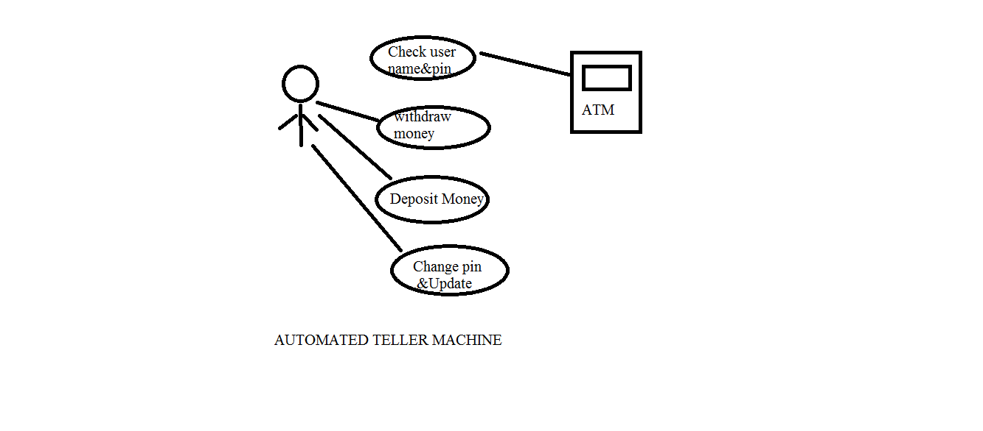
Uml Diagram

Slide 7
Main Feautres
In this ATM machine we have an option called change pin which is used to change our current pin if it is required

Slide 8
Advantages
Easy Access
Can use anywhere and at anytime

Slide 9
Software Requirements
Operating System - Windows 10.
Platform - Eclipse IDE and sqlyog.
Language - JAVA and JDBC
Files - JDK file

Slide 10
Conclusion
Automated Teller Machine can be used by any individual who have Bank account to withdraw,deposit money easily.Achieving this objective is difficult by going bank as it has long procedure to access our Account information and may be very time-consuming. All these problems are solved by this project.

Slide 11
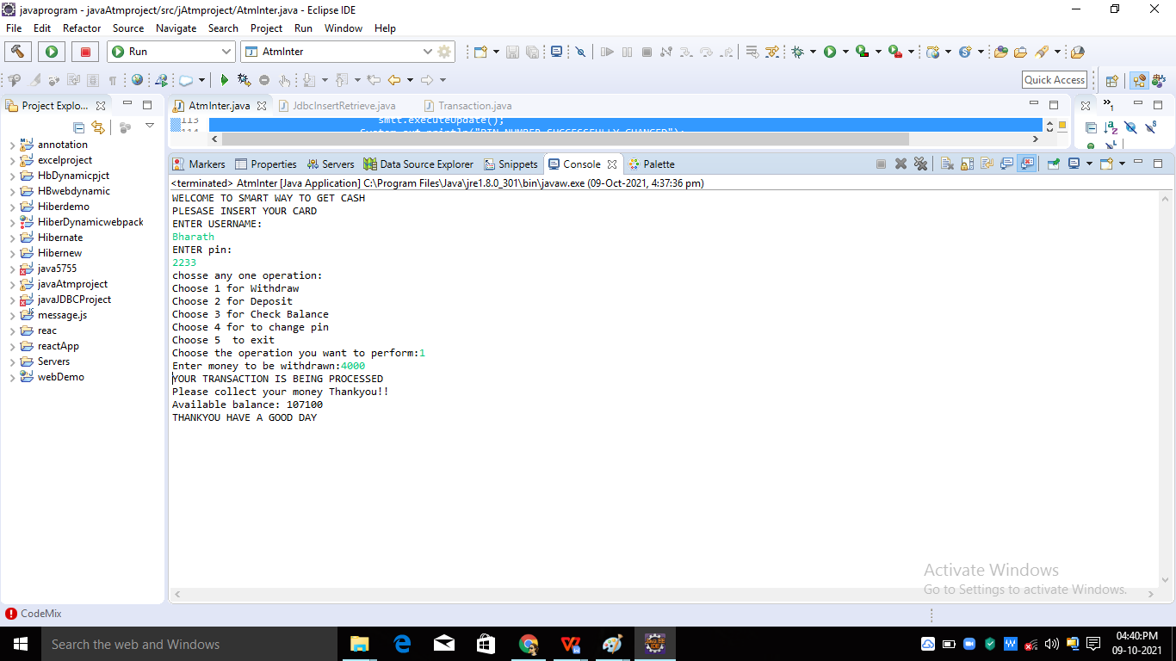
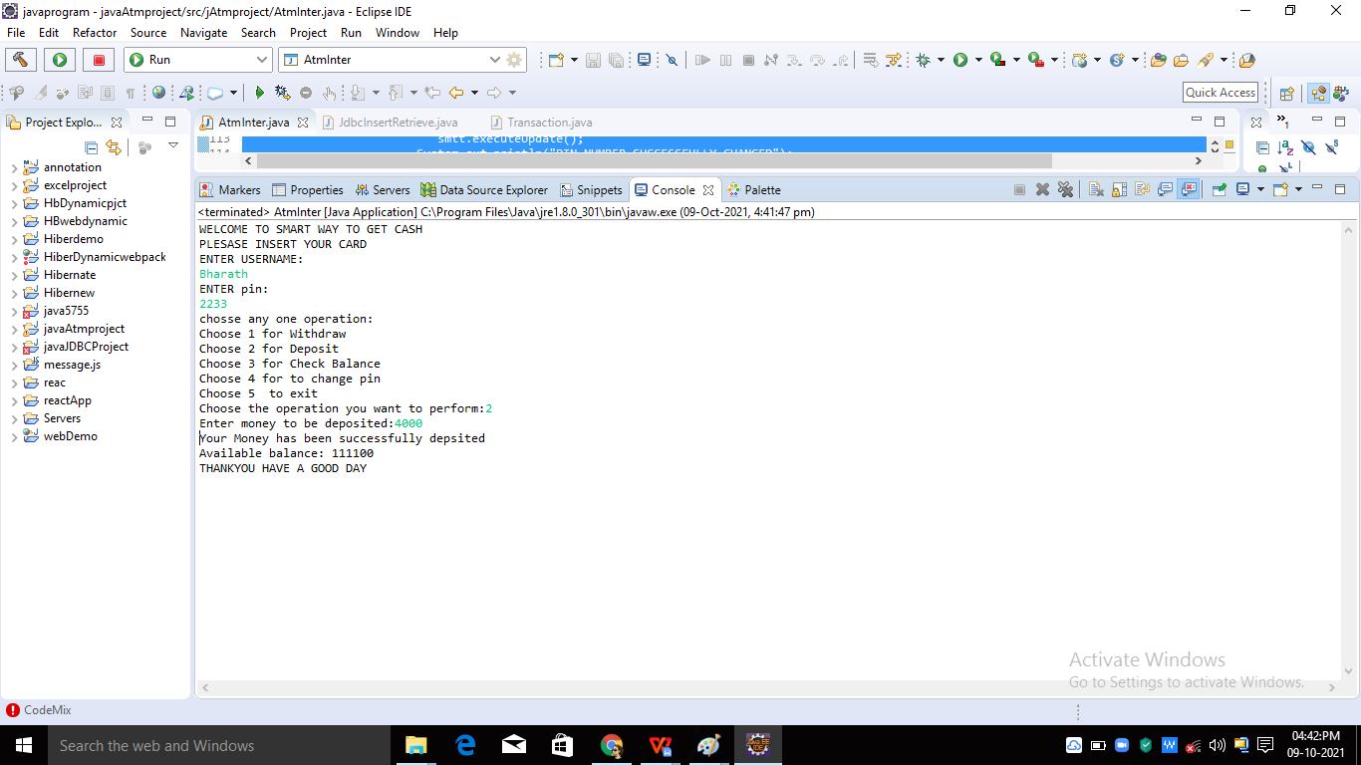
OUTPUT
LOGIN AND WITHDRAW
DEPOSIT MONEY

Slide 12
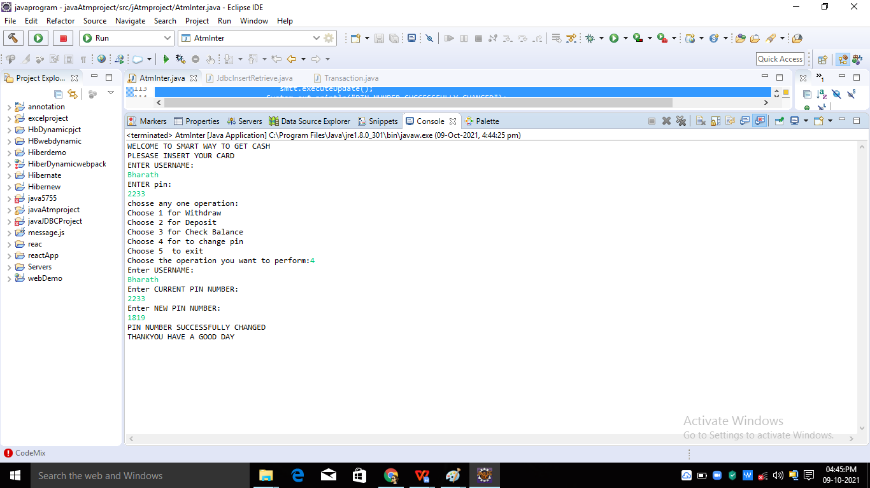
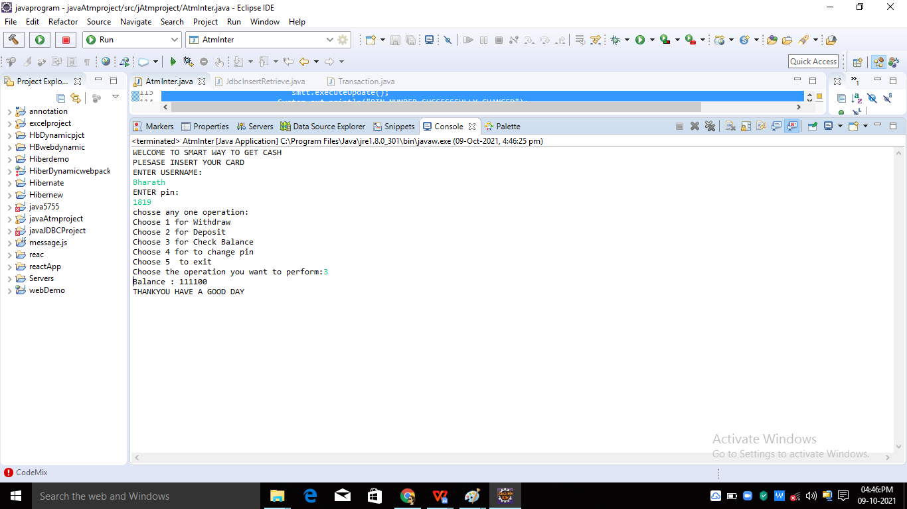
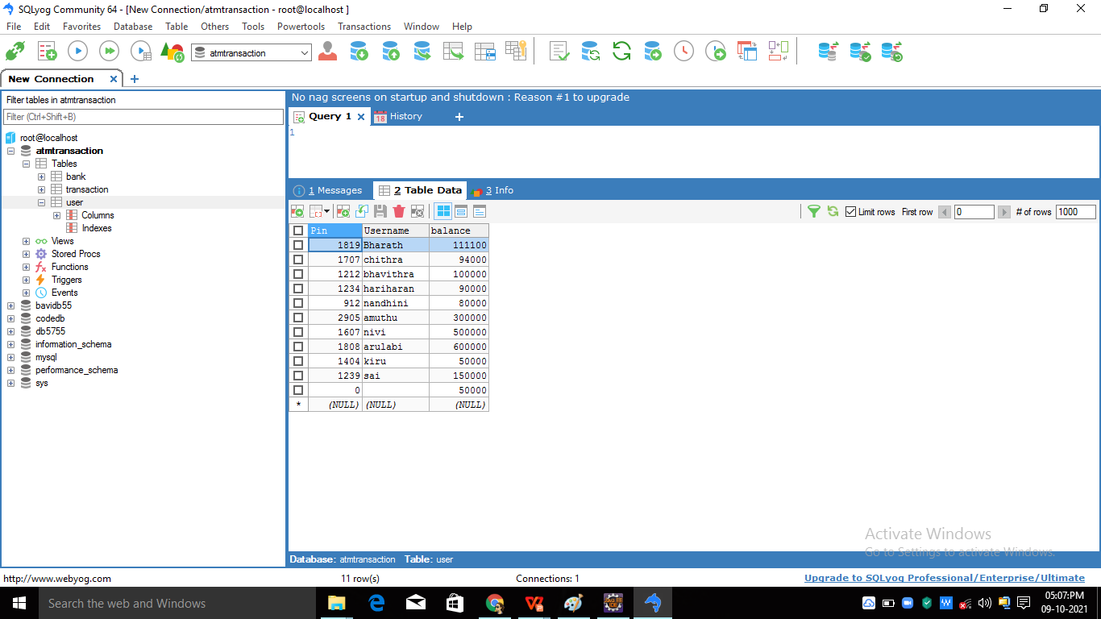
OUTPUT
CHANGE PIN
CHECK BALANCE
UPDATION OF EVERY OPERATON PERFORMED IN DATABASE

Slide 13
THANK YOU

